Slide 1
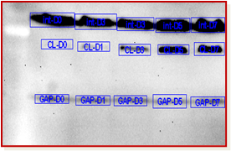
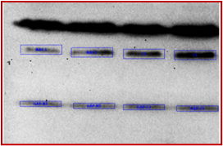
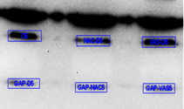

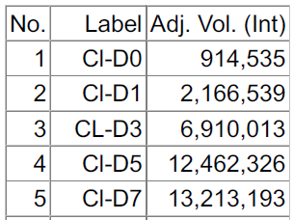


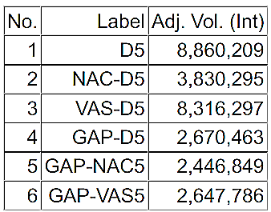
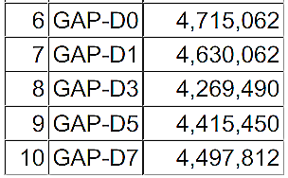

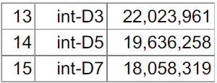
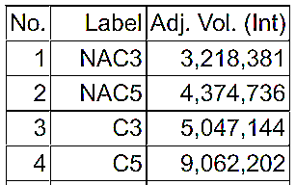

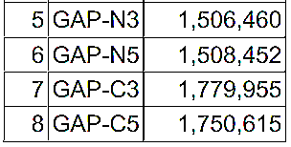
Supplementary Figure S1
Non-reducing SDS-PAGE
A
L D0 D1 D3 D5 D7
B
NACD3 NACD5 D3 D5
C
D5 NAC-D5 VAS-D5
130
100
70
Intact β3
55
Cleaved β3
GAPDH
analysis
analysis
analysis
Cleaved β3
GAPDH
Intact β3
GAPDH
Cleaved β3
Cleaved β3
GAPDH

