Slide 1
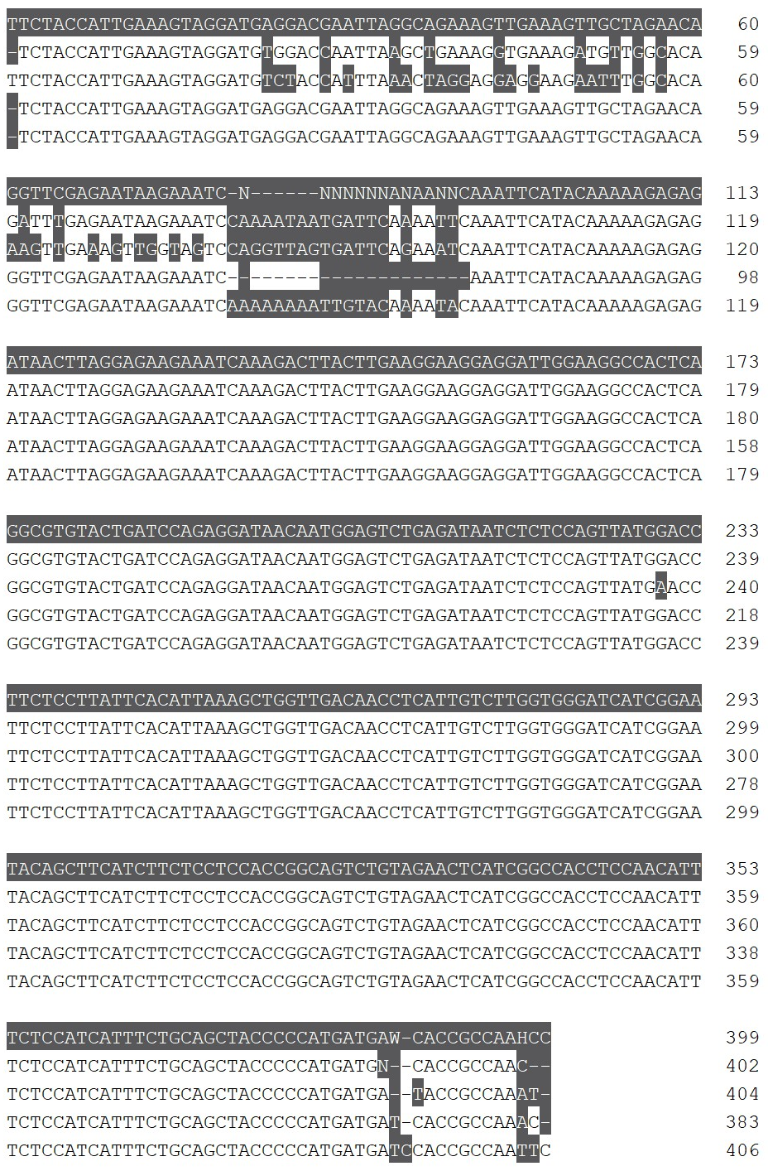
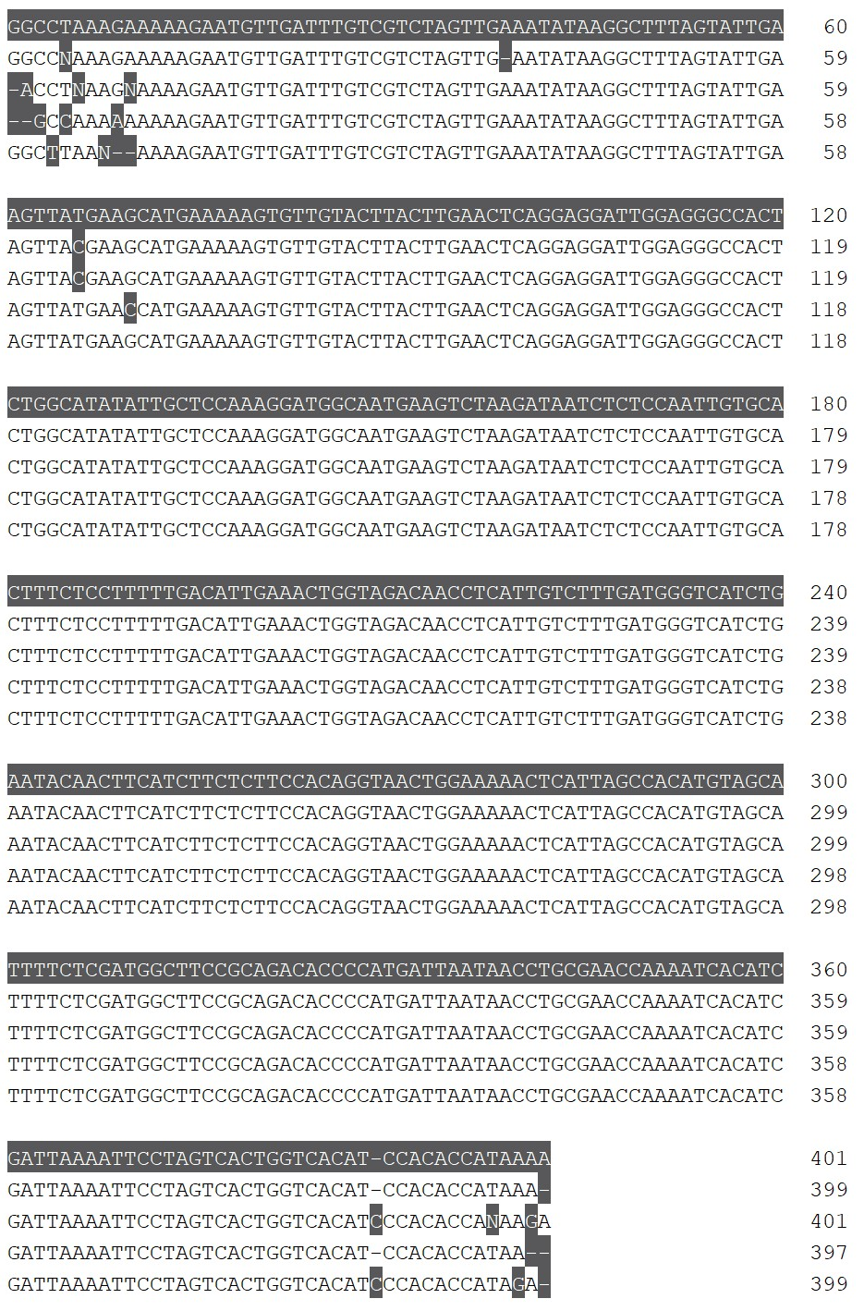
(a)
(b)
Consensus
Cabernet Sauvignon
Chardonnay
Sauvignon blanc
Shiraz
Consensus
Cabernet Sauvignon
Chardonnay
Sauvignon blanc
Shiraz
Consensus
*
Cabernet Sauvignon
Chardonnay
Sauvignon blanc
Shiraz
Consensus
Cabernet Sauvignon
Chardonnay
Sauvignon blanc
Shiraz
Consensus
Cabernet Sauvignon
Chardonnay
Sauvignon blanc
Shiraz
Consensus
Cabernet Sauvignon
Chardonnay
Sauvignon blanc
Shiraz
Consensus
Cabernet Sauvignon
Chardonnay
Sauvignon blanc
Shiraz
Supplemental Figure 1. Nucleotide sequence alignments of DMR6 wildtype amplicons.
Alignments of Sanger sequencing outputs from wildtype Shiraz, Chardonnay, Sauvignon blanc and Cabernet Sauvignon for (a) VviDMR6-1 and (b) VviDMR6-2 target region amplicons. The DM2c guide sequence is underlined in red and the red asterisk indicates the 1 bp mismatch in the VviDMR6-1 sequence.

