Slide 1
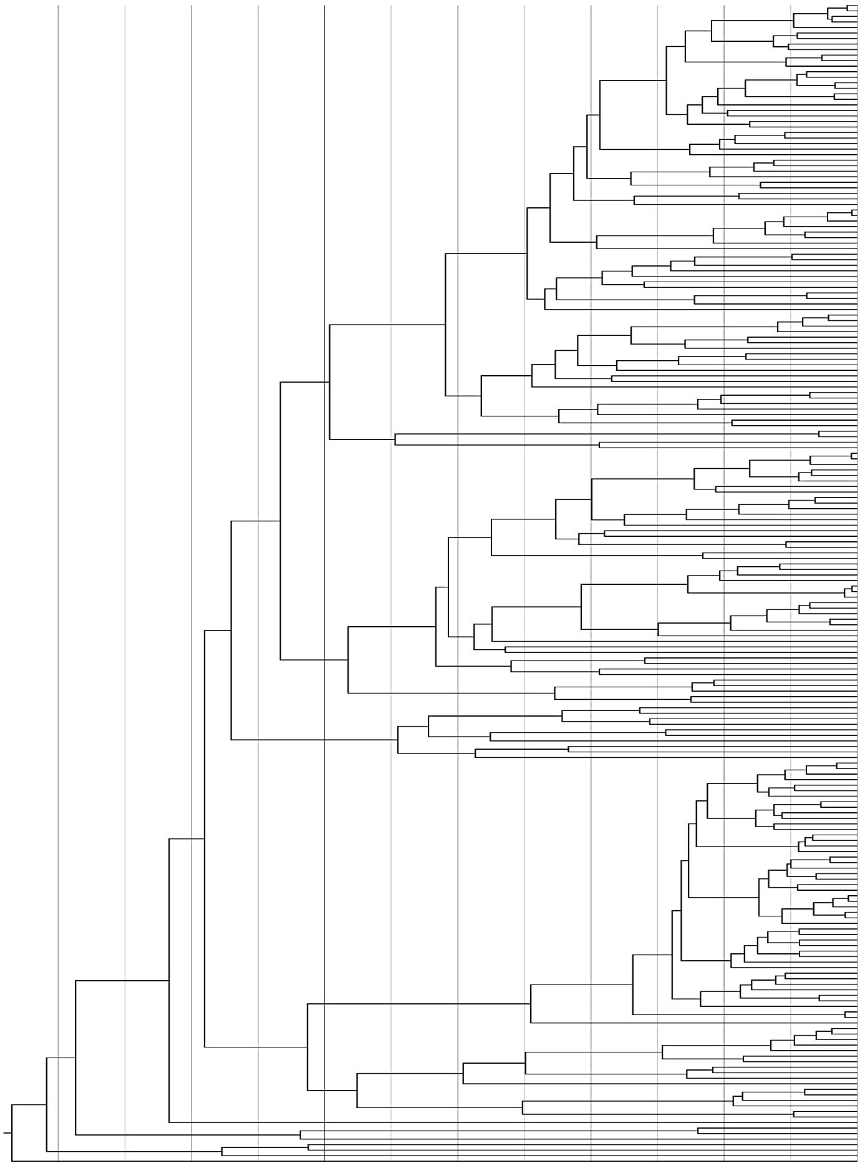
Appendix S3 Reconstruction of the biogeographical history for Papilionidae inferred by Bayes–DIVA
60 50 40 30 20 10
West Palaearctic (A)
East Palaearctic (B)
West Nearctic (C)
East Neactic (D)
Afrotropics (E)
Madagascan region (F)
Amazonian Neotropics (G)
Mexican region (H)
India (I)
Malayan region (J)
Australasian region (K)
JK
JK
JK
JK
JK
JK
JK
JK
Old World Papilio
Papilionini
CH
CH
New World Papilio
DH
BJ
GH
GH
GH
GH
GH
GH
BJ
BJ
Teinopalpini
BJ
South American genera
GH
GH
GH
GH
Australasian genera
JK
Papilioninae
Troidina
JK
JK
JK
JK
JK
JK
BJ
Troidini
BJ
JK
BJ
BJ
GH
Battina
GH
GH
GH
GH
DGH
Leptocircini
BIJ
GH
BIJ
BIJ
BJ
BI
BI
BI
BI
BI
BI
BI
BI
BI
BI
BI
AB
ABI
BI
ABI
ABI
ABI
ABI
ABI
ABI
BI
ABI
AB
AB
AB
Parnassius
ABI
AB
Papilionidae
BI
ABI
AB
Parnassiini
ABI
BI
ABI
BI
Parnassiinae
ABI
AB
Zerynthiini
AB
BI
AB
AB
BI
Baroniinae
Luehdorfiini
AB
Palaeocene
Eocene
Oligocene
Miocene
Pli.
Ple.
60 55 50 45 40 35 30 25 20 15 10 5 0 Time (Ma)

