Slide 1
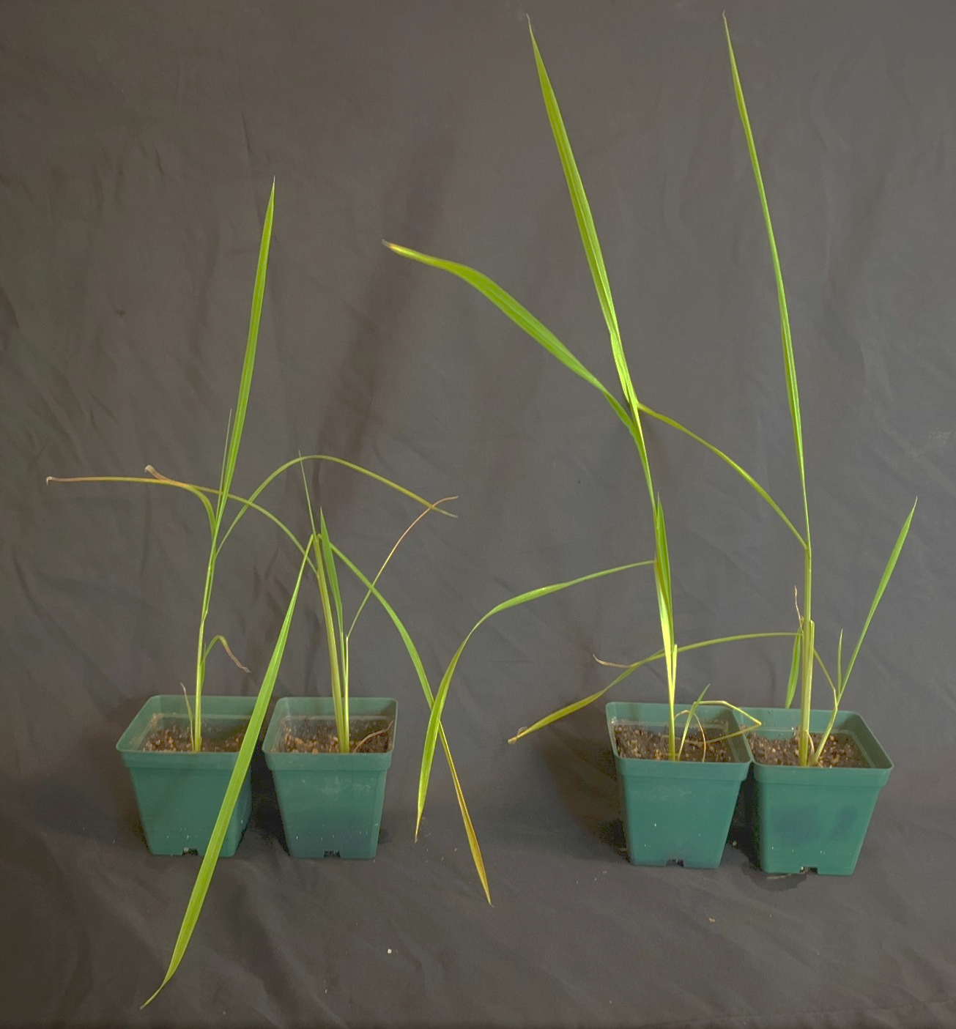
Non-transgenic (N)
Transgenic (T)
Supplementary Fig. S2: Water withholding assay. Representative plants of RD29a:DREB1a transgenic lines (T) and non-transgenic (N) lines subjected to dorught stress by water withholding. Photographs were taken at 10% SWC.

